Slide 1



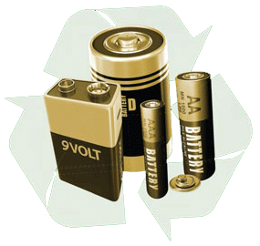

Slide 2
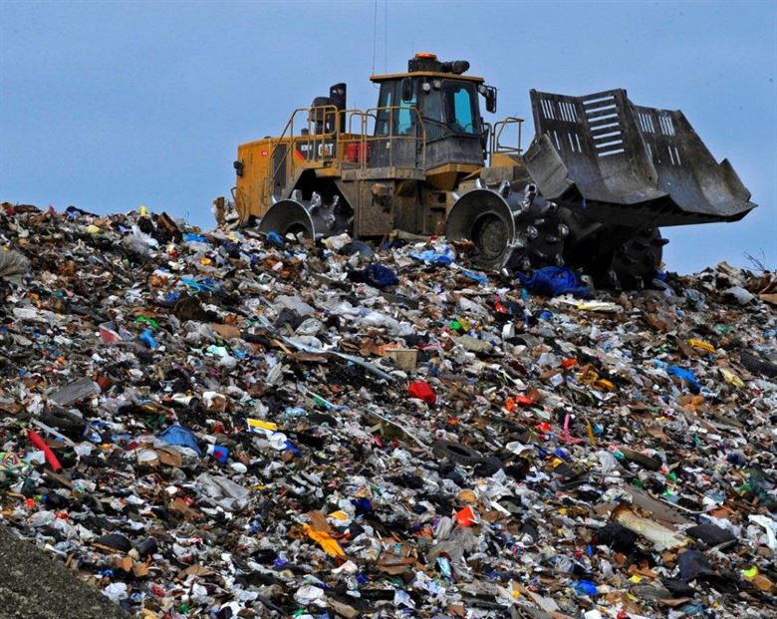
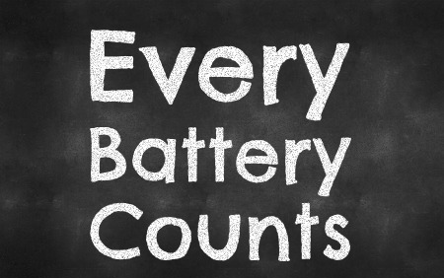
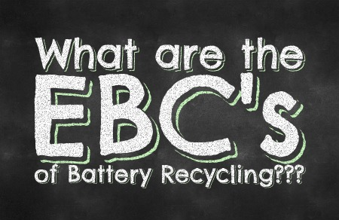

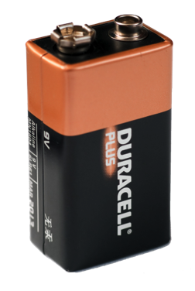
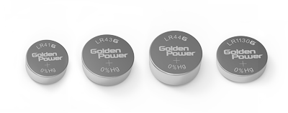
1% of waste is responsible for over 80% of all heavy metal waste found in landfills
Batteries are less than 1% of all landfill waste
What are the EBC’s of Battery Recycling?

Slide 3

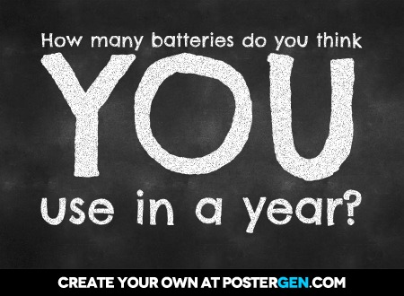


Slide 4

Where are batteries in your home?

Slide 5



Slide 6


Slide 7
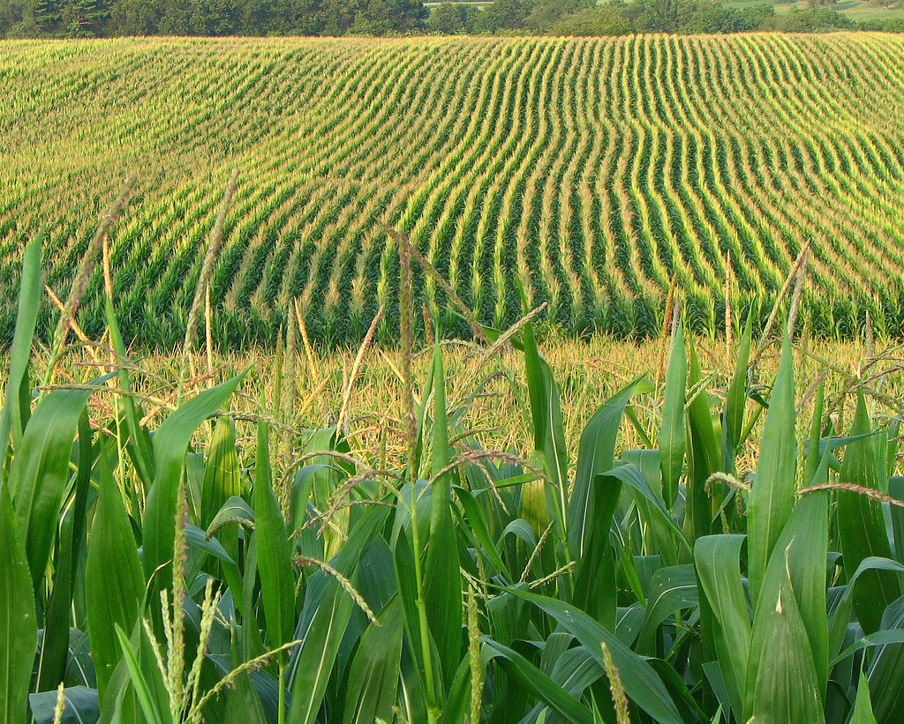




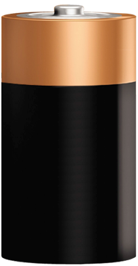
What’s inside a battery?
25%
STEEL & NICKEL
15%
PLASTIC & PAPER
60%
ZINC, MANGANESE
& POTASSIUM

Slide 8
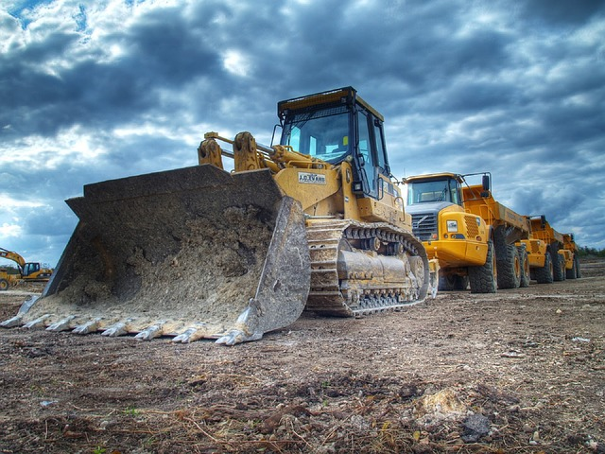



Slide 9



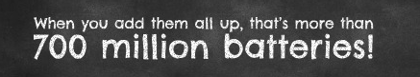
35,000,000
20 batteries each
700,000,000 batteries

Slide 10
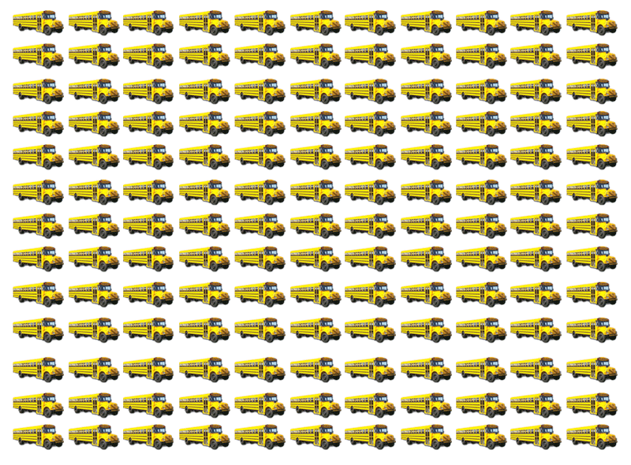
1,728 School Buses!

Slide 11







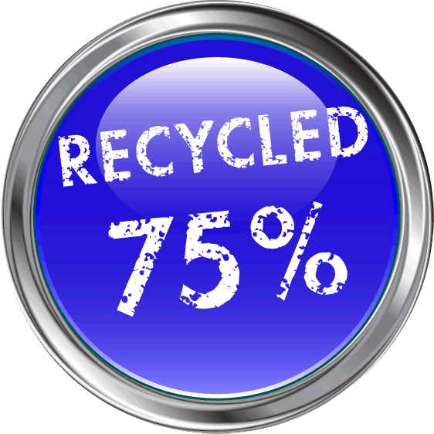


Slide 12



Slide 13
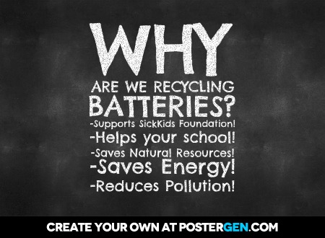

Slide 14


Slide 15

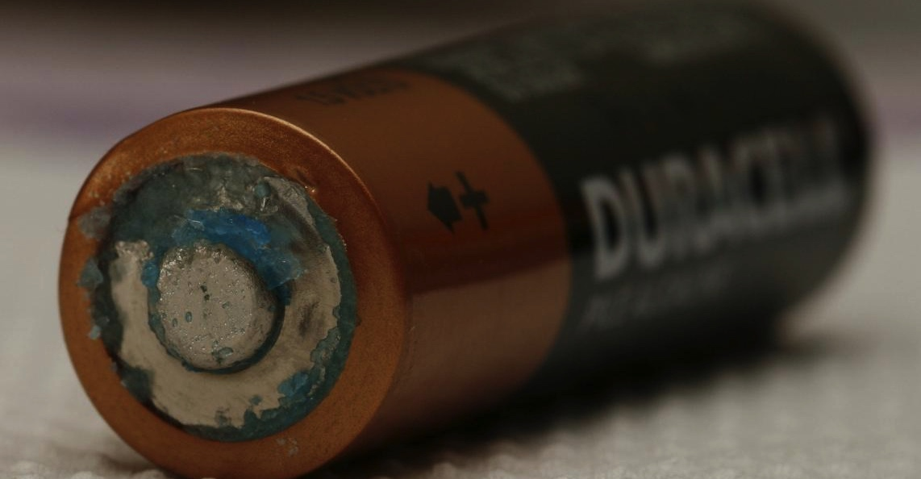

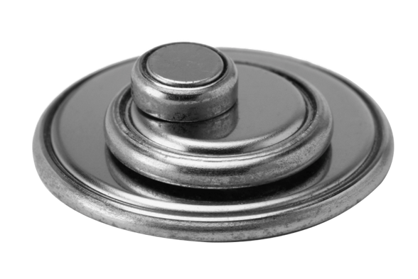

!
!
.

Slide 16

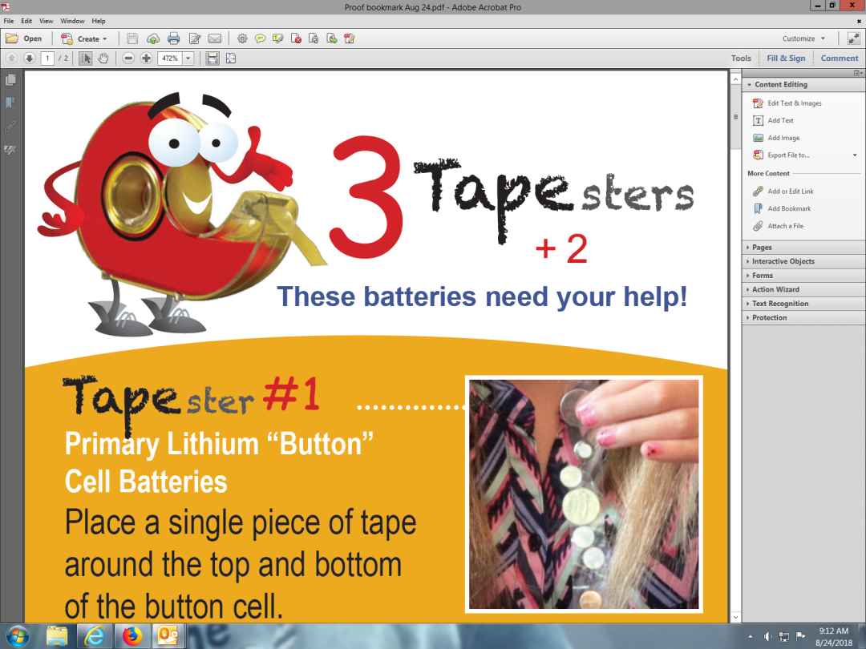

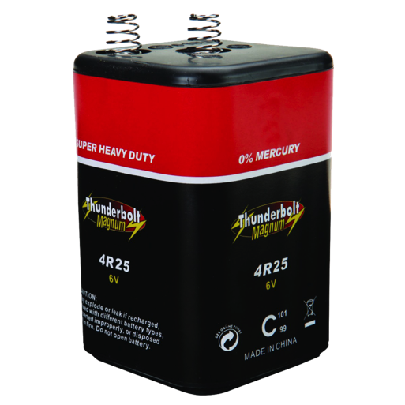


Slide 17


Taping VIDEO

Slide 18
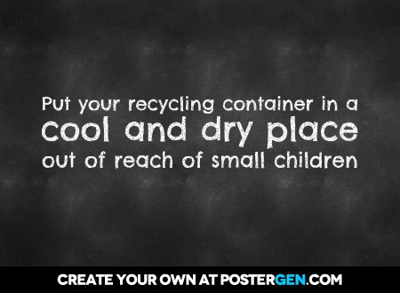
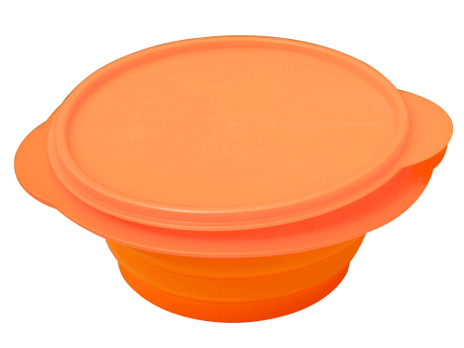

Store batteries at home in a plastic container

Slide 19


Slide 20
How many batteries does the average person use in one year?
20
28
10
30

Slide 21
Name the 3 Tapesters.

Slide 22
What resource is not inside a battery?
Plastic
Zinc
Steel
Cheese

Slide 23
Which batteries are the
PLUS 2?

Slide 24
Zinc, manganese and potassium are all…..?
Batteries
Corn
Minerals
Plastics

Slide 25
Which types of batteries should not be brought to school for recycling?
Alkaline
Lithium
Car Batteries
Rechargeable

Slide 26




Slide 27

Student mission video

Slide 28
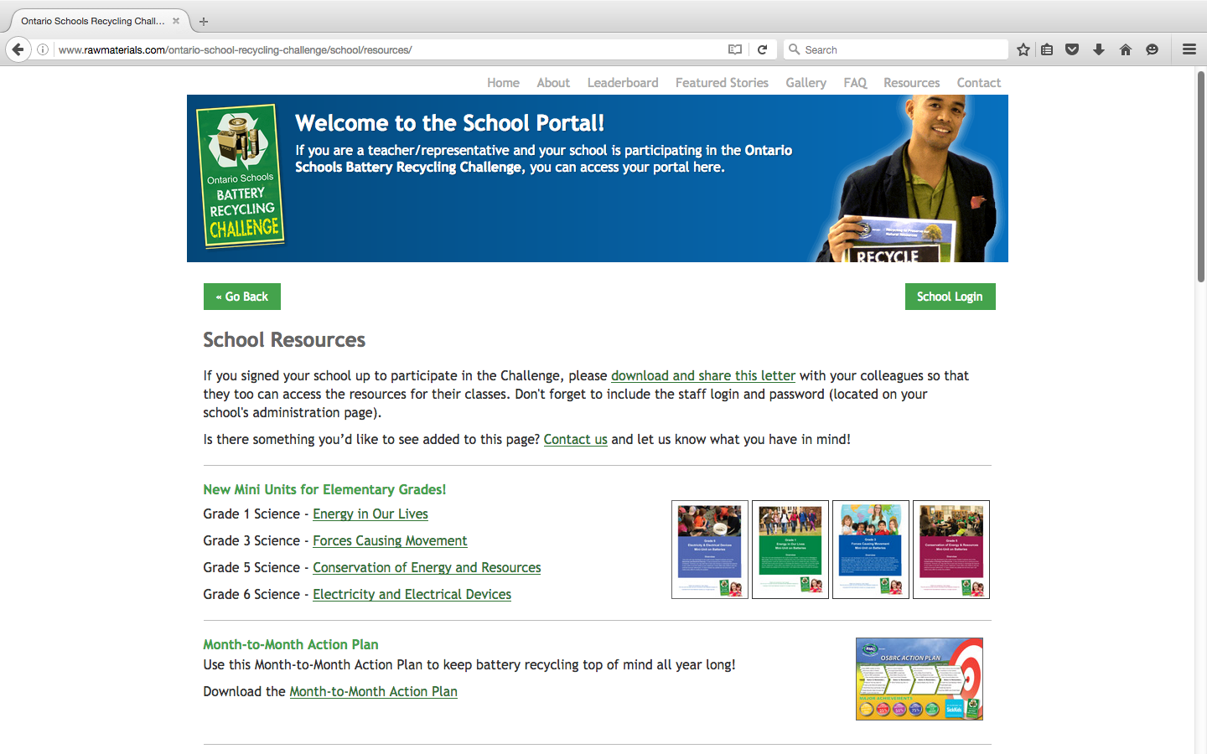


Slide 29
Sarah Lacharity
slacharity@rawmaterials.com
www.rawmaterials.com

